Slide 1

Placement cell
DATABASE MANAGEMENT SYSTEM

Slide 2

PURPOSE
INTRODUCTION
GOAL
EXIXTING SYSTEM
REQUIREMENTS
SYSTEM DESIGN
RESULT
CONCLUSION

Slide 3

INTRODUCTION
PLACEMENT CELL
Placement Cell is an online-based software application. so that the university site can provide the important points of their students in a database so that the companies obtain a suitable means of employment. begin the session.
The Placement Cell contains all information regarding students. The device stores all of your students’ personal information, such as your personal details, your added scars, your experience and your specialized skills that may be required in the CV that will be provided to a company.

Slide 4

GOALS
PLACEMENT CELL
Placement Cell goal is to provide a transparency between students and placement cell department
The proposed system is highly secured, because for login the system it requires the username and password which is different for each.
It maintains records for all the students.
Manages placement announcements.
The application can be put online easily and will be assessable throughout the globe.
This Photo by Unknown Author is licensed under CC BY-ND

Slide 5
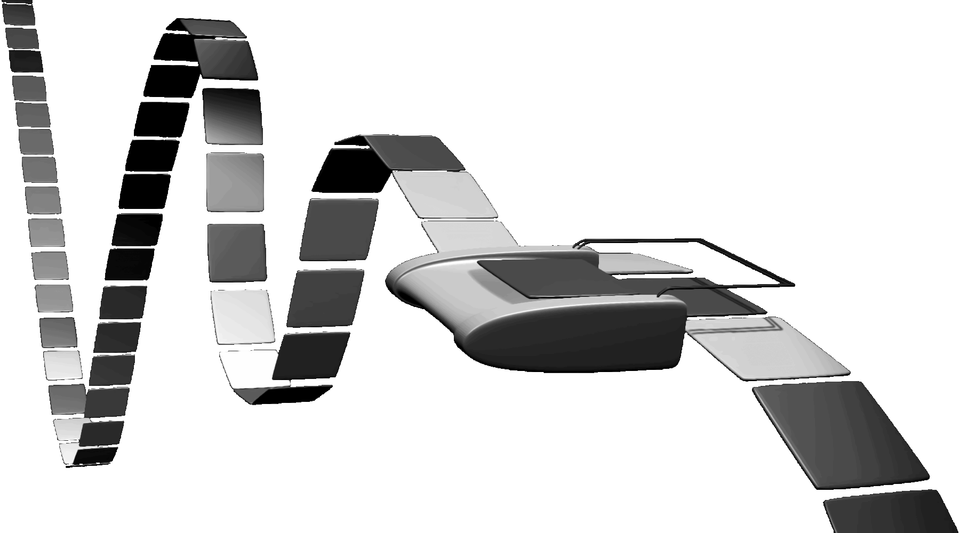
EXISTING SYSTEM
Filling physical forms by students.
Here a form is given to students in which he/she has to fill with some details such as his name, roll number, contact details, percentages (from first year to till date), Intermediate particulars (name of institution, place, year of pass, percentage), SSC particulars (name of institution, place, year of pass, percentage).
Collecting marks from green book Marks of each student are collected from green book (a book containing marks and other details maintained by each department in college).
Preparing excel sheet from the data collected through filled-forms and green book, excel sheets are prepared. These excel sheets are used to prepare a list of students who full-fill the requirements of a company visiting the campus and these students are eligible to attend the campus placement.

Slide 6

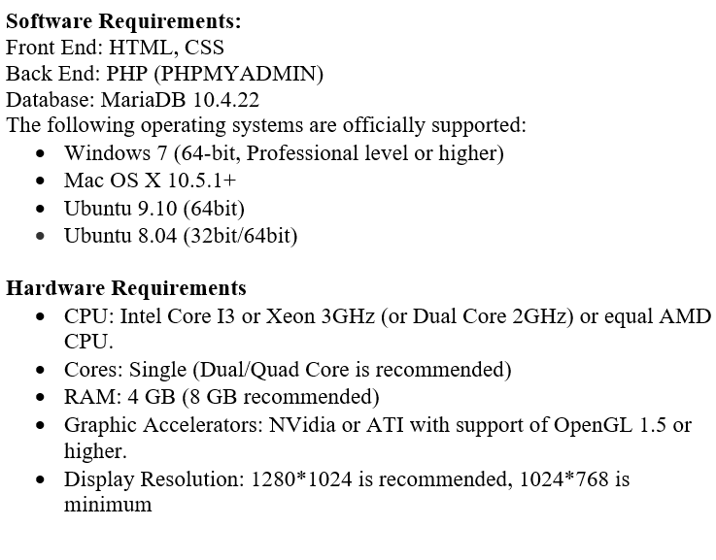
SYSTEM REQUIREMENTS
PLACEMENT CELL

Slide 7
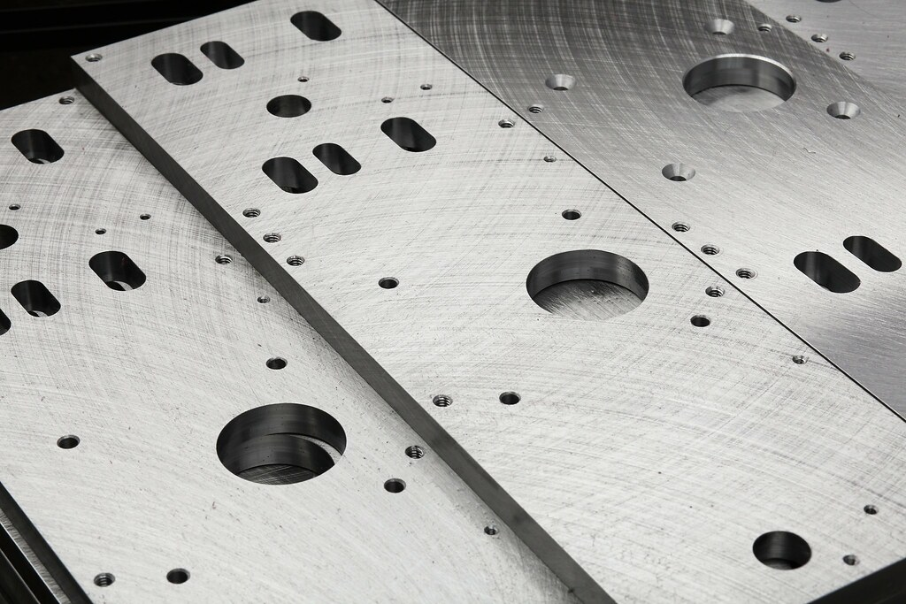
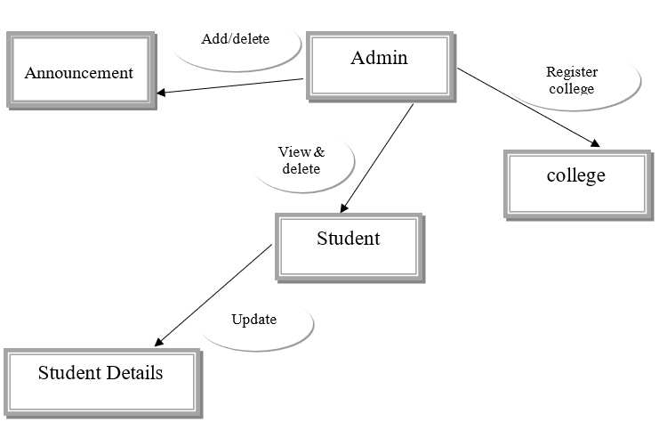
SYSTEM DESIGN
ER DIAGRAM
This Photo by Unknown Author is licensed under CC BY

Slide 8
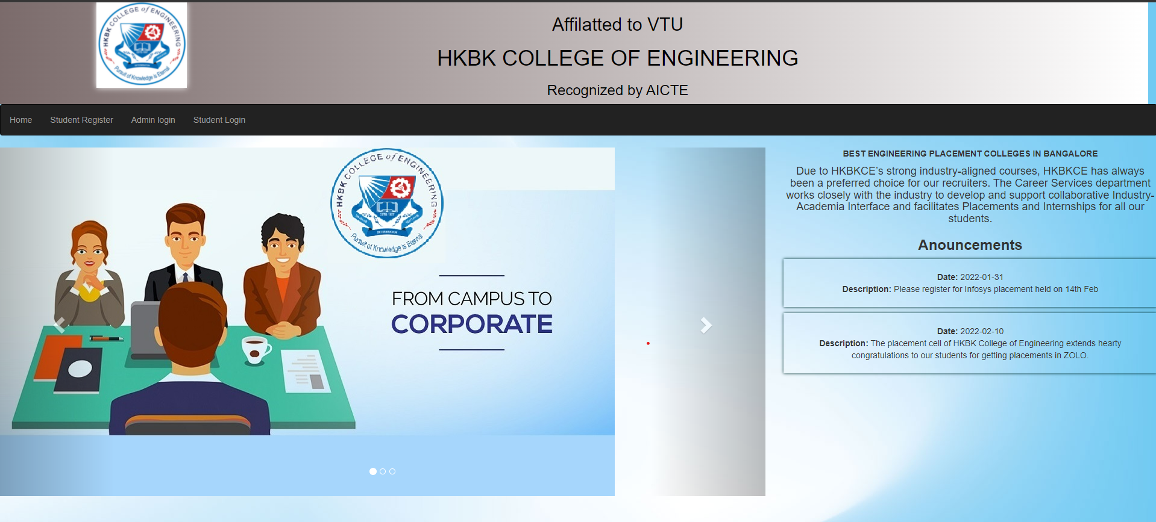
PLACEMENT CELL
Main Dashboard

Slide 9
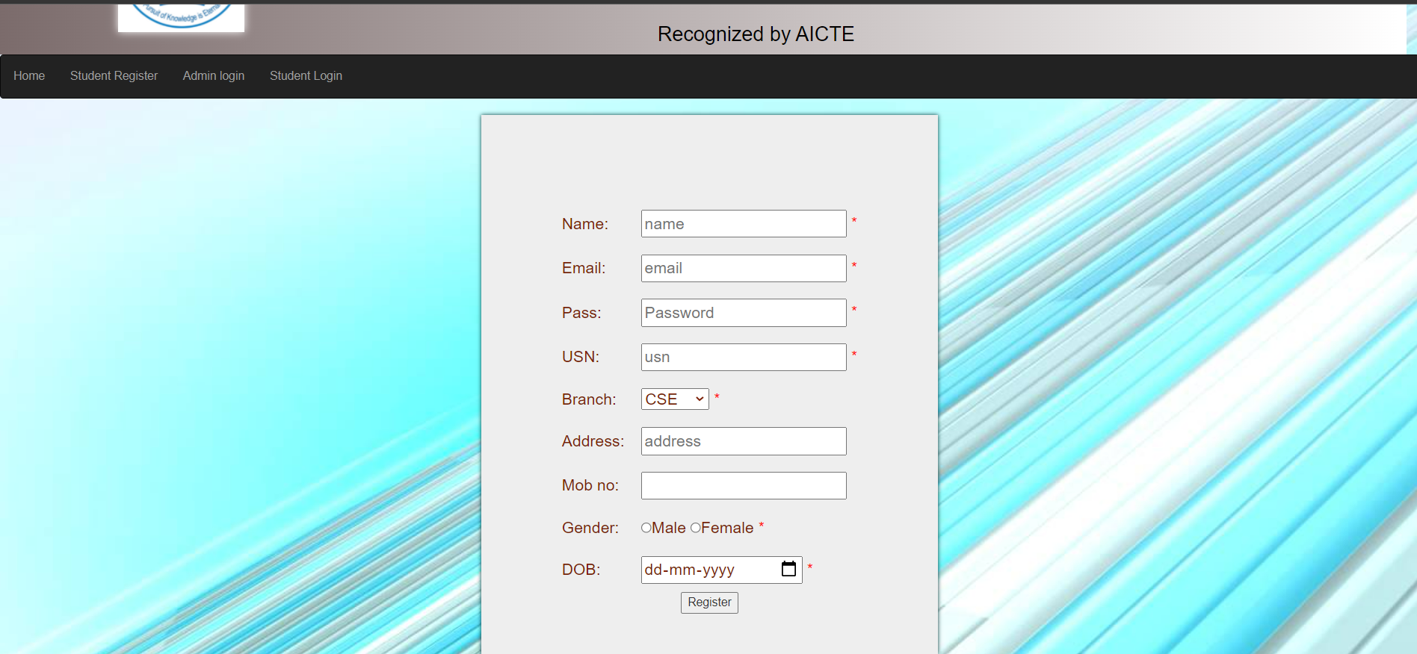
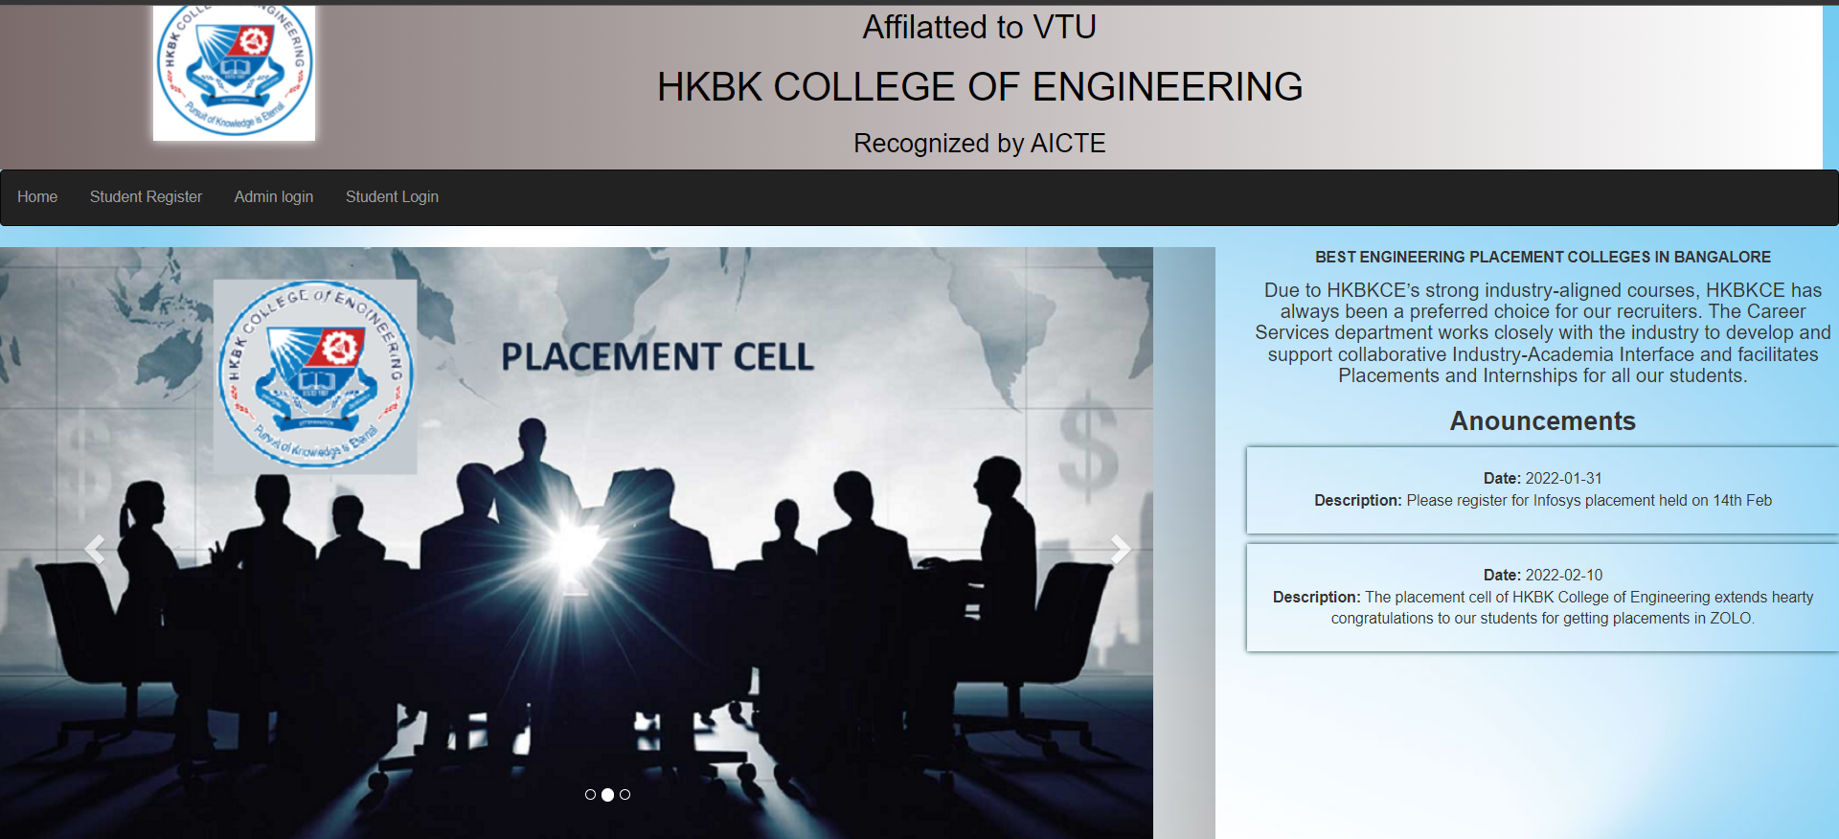
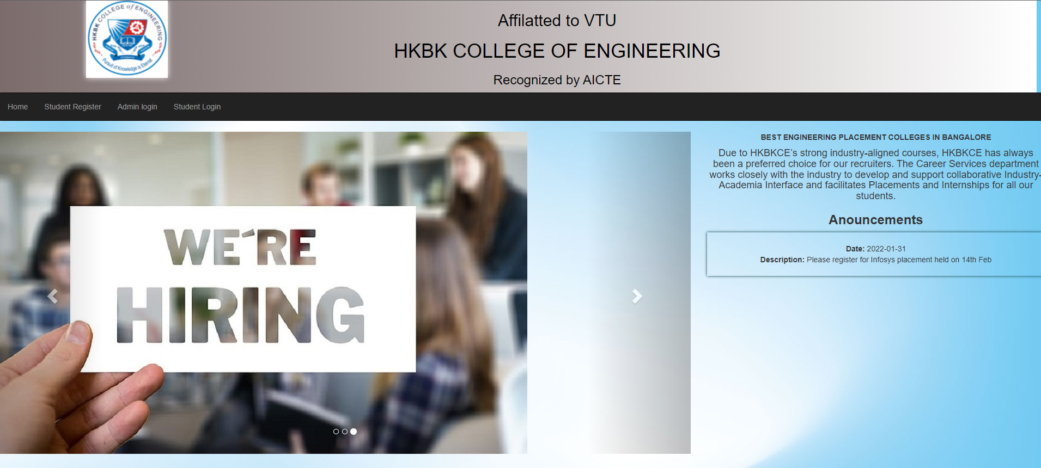
PLACEMENT CELL
Running : In the Operating system, whenever a new process is built, it is entered into the system, which should be running.
Not Running : The process that are not running are kept in a queue, which is waiting for their turn to execute. Each entry in the queue is a point to a specific process.
Registration Dashboard

Slide 10
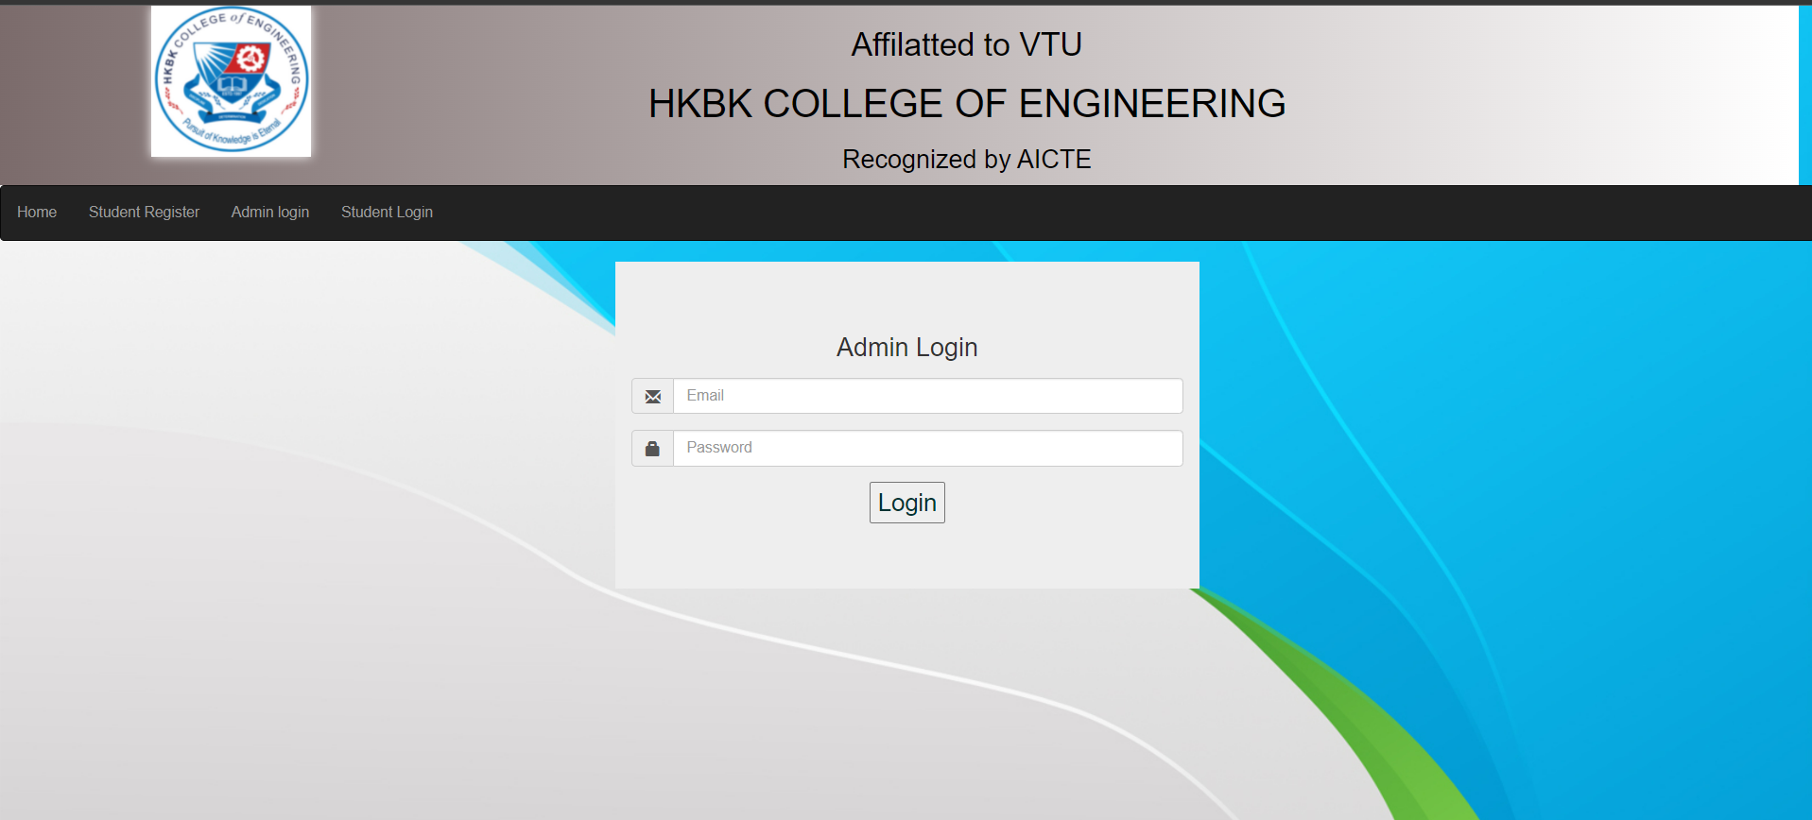
PLACEMENT CELL
Running : In the Operating system, whenever a new process is built, it is entered into the system, which should be running.
Not Running : The process that are not running are kept in a queue, which is waiting for their turn to execute. Each entry in the queue is a point to a specific process.
Admin Dashboard

Slide 11
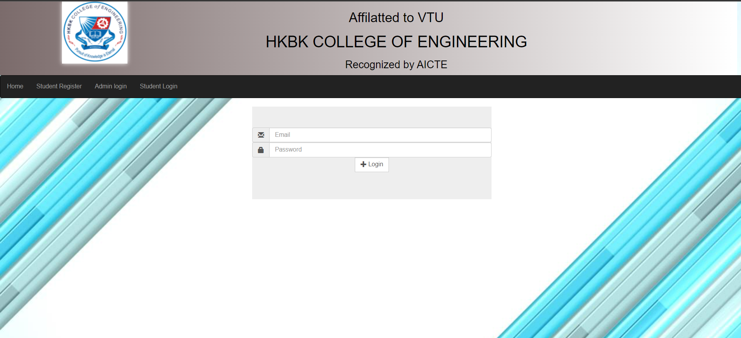
PLACEMENT CELL
Running : In the Operating system, whenever a new process is built, it is entered into the system, which should be running.
Not Running : The process that are not running are kept in a queue, which is waiting for their turn to execute. Each entry in the queue is a point to a specific process.
Student Login Dashboard

Slide 12

Introduction to environment
What is PHP?
PHP can generate dynamic page content
PHP can create, open, read, write, delete, and close files on the server
PHP can collect form data
PHP can send and receive cookies
PHP can add, delete, modify data in your database
PHP can be used to control user-access
PHP can encrypt data
Why PHP?
PHP runs on various platforms (Windows, Linux, Unix, Mac OS X, etc.)
PHP is compatible with almost all servers used today (Apache, IIS, etc.)
PHP supports a wide range of databases
PHP is free.
PHP is easy to learn and runs efficiently on the server side

Slide 13

conclusion
Based on the research, even though it is an upcoming system, but with proper improvements to it, this process will get popular in the future. There are lots of procedures during a placement drive, but each section takes its own time.
During this period, students face a lot of stress as they must face the all the round and at last face the interview, that for some students might be tough to overcome, and hence not getting the job. The stress of the student is an important factor during a placement drive. This stress is also a large reason for unemployment of educated students.
The existing system works manually and there is no verification about the participants data is done. Even in the interview process the contestants must attend with hard copies of their documents, this is time consuming and energy wastage.
A future for students with busy schedules, this project may be a time saver and become more helpful for the students and the companies together.

Slide 14


THANK YOU
Shubhanshu Kumar (1HK20CS409)
Uzma Anwer (1HK20CS410)
1hk20cs409@hkbk.edu.in
1hk20cs410@hkbk.edu.in
shubhanshubb.github.io

